Slide 1
Lake Shore High School Girls Soccer Spring 2021
Pre-Season Parent Meeting

Slide 2
Contacts
Head Coach
David Lount
dlount@lsps.org
JV Coach
Christopher Gwozdz
Cgwozdz@lsps.org

Slide 3
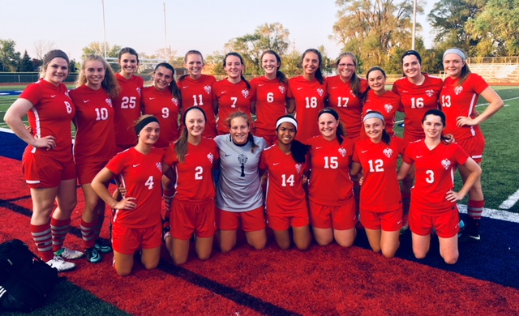
2021 LSHS GIRLS SOCCER
The Lake Shore girls soccer team competes in the MAC White division.
District Champions 2017
MAC Blue Champions 2018, 2015 and 2014
MAC Gold in 2008 and 2006

Slide 4
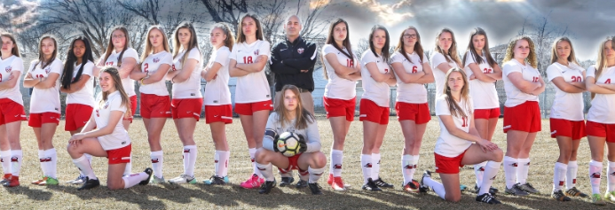
Schedules
Athletics Page
http://lakeshoreschools.org/athletics/girls_soccerMAC Page
macombmac
http://macombmac.misd.net/
LSHS Soccer Website
http://www.lakeshoresoccer.weebly.com

Slide 5
TRANSPORTATION
Transportation will be one way unless schools are further than 10 miles from Lake Shore. (2021 will be two way bussing to all schools)

Slide 6
COVID INFO
Testing Mondays @ 10am. Beginning April 12 in the gym
Bring your own water to practice and games
Wear masks at all times(playing or not)
If we get quarantined, that would be a 1/3 of our season.

Slide 7
Eligibility Requirements
Academic/passing four classes
Physical/Emergency card on file
Meets the guidelines under the MHSAA transfer rule.

Slide 8
Behavior Expectations
Players will be respectful by using appropriate language when interacting with other players, coaches, referees, parents and spectators. Players will not taunt, use obscene gestures or attempt to demean others. HAZING WILL NOT BE TOLERATED.
Players will arrive on time, properly dressed and equipped, for all practices, games and meetings. Coaches will be notified of any irregularities, immediately.
Players will practice and exhibit good sportsmanship.
Players will use appropriate behavior on social media(twitter, etc.)

Slide 9
Team Routines
Players will remain on the bench during games, unless subbing, consulting with the trainer or warming up.
Players will report to home games 45 minutes before game time and meet at the place designated by the coach.
Players will participate as instructed during the pre-game warm-up.
Players will attend all practices properly dressed and equipped. Before the formal practice begins, players are to work on individual skills.
All equipment will be retrieved and all litter removed at the end of all games and practices. This responsibility belongs to everyone.

Slide 10
Consequences for Violating Team Rules
1st Offense: Verbal Warning
2nd Offense: Loss of ½ half of playing time
3rd Offense: Loss of a game and meeting with parents
4th Offense: Referral to Athletic Director
5th Offense: Possible removal from the team
Any players who refuse to accept consequences for their behavior will be denied participation in the program, until the conflict is resolved. All team rules are in addition to all School and District policies.

Slide 11
TEAM APPAREL
All players will receive shorts, two jerseys and a team bag. These are school property and are only to be worn for Lake Shore Soccer Games.
The only piece of clothing players must purchase are two pairs of team socks.
We will be using red and white Adidas metro IV sock.
Team spirit wear and other gear can be purchased but IS NOT REQUIRED!

Slide 12
Follow Shorian Soccer
Follow updates to the girls soccer team by using Remind. Text @shorian to 81010 to sign up.
Miprepzone Macomb usually has game recaps from the macomb daily.

